Slide 1

UNIVERSITY INSTITUTE OF SCIENCES
Academic Unit V
Bachelor of Engineering
(Computer Science & Engineering)
Biology For Engineers 23SZT148
Smart Medical Instrumentation Systems
DISCOVER . LEARN . EMPOWER

Slide 2
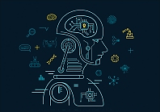
Course Outcome
CO Number | Title | Level
CO1 | Identify the biological concepts from an engineering perspective. | knowledge
CO2 | Development of artificial systems mimicking human action. | Understand
CO3 | Explain the basic of genetics that helps to identify and formulate problems | Analyze
CO4 | Apply knowledge of measurement system, biomedical recording system and biosensors to excel in areas such as entrepreneurship, medicine, government, and education. | Apply
CO5 | Integrate biological principles for developing next generation technologies, | Create
Will be covered in this lecture
https://images.app.goo.gl/5obqqxo93P2UBmdU6

Slide 3

SYLLABUS
Unit-2 | Biosensors and measurement system | Contact Hours: 15
Chapter 1 Medical Instrumentation Chapter 2 Measurement System Chapter 3 Biological Sensor | Medical Instrumentation: Sources of biomedical Signals, Basic medical Instrumentation system, Performance requirements of medical Instrumentation System, Microprocessors in Medical instruments, PC base medical Instruments, General constraints in the design of medical Instrumentation system, Regulation of Medical Devices. Measurement System: Specification of instruments, Statics & Dynamic characteristics of medical instruments, Classification of errors. Statistical analysis, Reliability, Accuracy, Fidelity, Speed of responses, Linearization of technique, and Data Acquisition System. Biological sensors: Sensors/ receptors in the human body, basic organization of the nervous system- neural mechanism, Chemoreceptor: hot and cold receptors, sensors for smell, sound, vision, Ion exchange membrane electrodes, enzyme, glucose sensors, immunosensors, & biosensors & applications of biosensors.

Slide 4
Smart Medical Instrumentation Systems
Microprocessors in Medical instruments
PC base medical Instruments
General constraints in design of medical Instrumentation system
Regulation of Medical Devices

Slide 5
The application of Microprocessors in Medical Instrumentation

Slide 6
What is a Microprocessor?
A microprocessor is a computer processor that incorporates the functions of a central processing unit (CPU) on a single integrated circuit (IC) or sometimes up to 8 integrated circuits.
A microprocessor is programmable, multipurpose, clock-driven, register based electronic device that reads binary instructions from a storage device called memory, accepts binary data as input and processes data according to the instructions and then provides results as output.
A digital computer with one microprocessor which acts as a CPU is called Microcomputer.

Slide 7
Application of Microprocessors in Medical Instrumentation
Microprocessors have replaced conventional hard wired electronic systems that were initially used for processing data.
This has resulted into a more reliable and faster data.
Microprocessor system replaced programming devices as well as manual programming, making it possible for digital control of all the functions in medical instrumentation systems.
The availability of more powerful microprocessors and large data storage capacities has made it possible to optimize the measurement conditions.

Slide 8
Applications in Biomedical Instrumentation:
Patient Monitoring Systems
Microprocessors are used in devices like ECG (Electrocardiogram) machines, pulse oximeters, and blood pressure monitors to collect, process, and display patient data.
Example: A microprocessor in an ECG machine collects electrical signals from electrodes on a patient's body, processes the signals to create a readable ECG waveform, and displays it on a screen.

Slide 9
Medical Imaging Systems:
Microprocessors are employed in medical imaging equipment such as X-ray machines, CT (Computed Tomography) scanners, and MRI (Magnetic Resonance Imaging) scanners to control the imaging process and handle data acquisition.
Example: In a CT scanner, a microprocessor coordinates the movement of the X-ray source and detectors, processes the collected data, and generates cross-sectional images of the patient's body.

Slide 10
Infusion Pumps:
Infusion pumps used in hospitals and clinics to deliver precise doses of medication or fluids rely on microprocessors for accurate control.
Example: A microprocessor in an infusion pump regulates the flow rate and ensures that the prescribed medication is administered safely.

Slide 11
Implantable Medical Devices:
Microprocessors are used in implantable medical devices like pacemakers and insulin pumps to monitor physiological conditions and deliver therapy as needed.
Example: A microprocessor in a pacemaker constantly monitors a patient's heart rate and delivers electrical pulses when necessary to regulate the heartbeat.

Slide 12
Laboratory Analyzers:
Microprocessors are found in laboratory equipment, such as blood analyzers and DNA sequencers, to automate sample analysis and data processing.
Example: A microprocessor in a blood analyzer processes blood samples, measures various parameters, and provides test results quickly and accurately.

Slide 13
Prosthetic Devices:
Microprocessors are used in advanced prosthetic limbs to provide more natural and precise control over movements.
Example: A microprocessor in a prosthetic hand can detect muscle signals from the wearer's residual limb and translate them into specific hand movements.

Slide 14
In biomedical instrumentation, microprocessors are crucial for ensuring accuracy, reliability, and real-time data processing. They enable healthcare professionals to diagnose, monitor, and treat patients more effectively, improving the overall quality of healthcare.

Slide 15
PC Base Medical Instruments

Slide 16
Personal computer are popular in medical field and also software is largely commercially available and the users can purchase and use it.
Computer are widely accepted in the medical field for data collection, manipulation, processing and a complete workstations for a variety of applications
A personal computer becomes a workstation with the simple installation of one or more ‘instruments-on-a-board’ in its accessory slots.

Slide 17
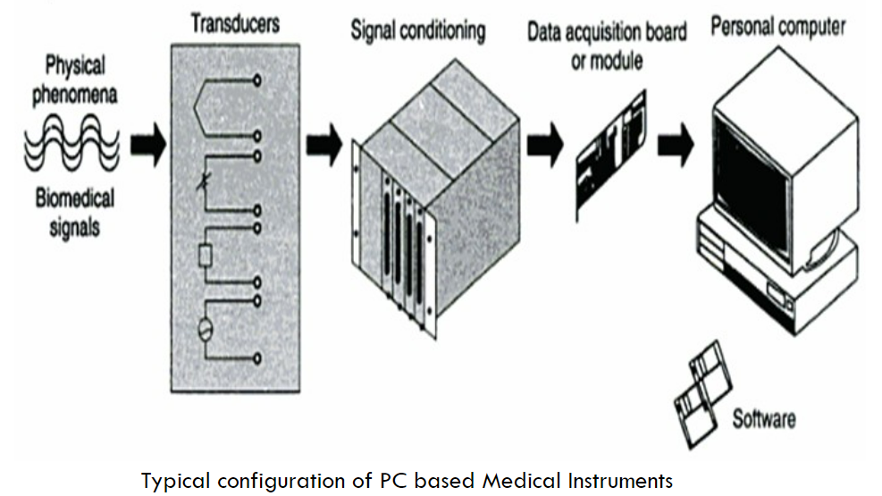

Slide 18
System is highly flexible and can accommodate a variety of inputs, which can be connected to PC for analysis, graphics and control
The systems works totally under the control of software
PC medical instruments are gaining in popularity for several reasons including price, programmability and performance specifications
Basic elements in the system include sensors or transducers that convert physical phenomena into a measurable signal, a data acquisition system, an accquistion/analysis software package or programme and computing platform.

Slide 19
Software development, rather than hardware development, increasingly dominates new product design cycles
Microprocessors have been used to replace the complicated instructional procedures that are now required in some medical instruments.
Microprocessors based instrumentation has enabled the ability to make intelligent judgement and provide diagnostic signals/warnings in case of potential error or even take appropriate corrections!
This includes operating systems, devices drivers, libraries, languages and debugging tools

Slide 20
Advantages of PC-based medical instruments
Cost-Effective: PC-based medical instruments are often more cost-effective than standalone devices with integrated displays and processing units. This is because they leverage the computing power of readily available PCs, reducing the need for specialized hardware.
Scalability: These instruments can be easily upgraded or customized by simply upgrading the PC's hardware or software. This scalability allows for the addition of new features or capabilities without replacing the entire instrument.

Slide 21
Processing Power: Modern PCs have substantial processing power, making them capable of handling complex data analysis, signal processing, and image processing tasks. This enables high-resolution data collection and sophisticated analysis techniques.
User-Friendly Interface: PCs offer user-friendly interfaces with graphical displays, touchscreens, and interactive software. This makes it easier for healthcare professionals to operate and interpret the data from these instruments.

Slide 22
Data Storage and Management: PC-based instruments can store large volumes of patient data in electronic formats, making it easier to manage and retrieve patient records. They also enable connectivity to electronic health record (EHR) systems.
Remote Monitoring: Remote monitoring and telemedicine applications are facilitated by PC-based instruments. Healthcare providers can access patient data and perform diagnostics from remote locations

Slide 23
Applications
Medical Imaging: PC-based medical instruments are extensively used in medical imaging modalities such as ultrasound, MRI, CT scans, and digital radiography. The PC handles image acquisition, processing, and visualization.
Electrocardiography (ECG): PC-based ECG machines capture and analyze electrical signals from the heart, providing detailed ECG reports that can be printed or stored electronically.
Spirometry: Spirometers connected to PCs measure lung function and help diagnose respiratory conditions like asthma and chronic obstructive pulmonary disease (COPD).

Slide 24
Electroencephalography (EEG): EEG systems connected to PCs record brainwave activity and are used in diagnosing neurological disorders and monitoring brain function.
Laboratory Analyzers: PC-based systems are employed in clinical laboratories for automated analysis of blood, urine, and other biological samples, offering faster and more accurate results.
Patient Monitoring: PC-based monitoring systems track vital signs such as heart rate, blood pressure, and oxygen saturation. They can provide real-time data and alarms in hospital settings.

Slide 25
Telemedicine: PC-based instruments support telemedicine applications, allowing healthcare providers to remotely diagnose and monitor patients, especially in remote or underserved areas.
Research and Education: PC-based instruments are used in research laboratories and educational institutions for conducting experiments, simulations, and medical training.
Rehabilitation and Assistive Devices: Devices like robotic exoskeletons and prosthetic limbs often rely on PC-based control systems for precise and adaptive movements.
Dental Imaging: In dentistry, PC-based instruments are used for digital dental radiography and 3D imaging, improving diagnostic accuracy and patient car

Slide 26
General constraints in design of Medical Instrumentation System

Slide 27
The design of medical instrumentation systems is subject to various constraints and considerations to ensure their safety, accuracy, reliability, and effectiveness in healthcare applications. Here are some general constraints and considerations that designers must address:
Patient Safety: Ensuring the safety of the patient is paramount. The system should not harm the patient through electrical, mechanical, or thermal means.
Accuracy and Precision: Medical instruments must provide accurate and precise measurements or data. Errors in measurements can lead to incorrect diagnoses or treatments.

Slide 28
Reliability: Medical instruments must operate reliably without unexpected failures. They are often used in critical healthcare situations where any malfunction can have serious consequences.
Regulatory Compliance: Medical instrumentation must adhere to various regulatory standards and certifications, such as FDA approval in the United States, CE marking in Europe, and ISO 13485 for quality management.

Slide 29
Data Security and Privacy: Protecting patient data is crucial. Systems must comply with data security and privacy regulations, such as HIPAA (Health Insurance Portability and Accountability Act) in the United States.
Compatibility: Medical instruments should be compatible with existing healthcare infrastructure and systems, including electronic health records (EHRs) and hospital information systems (HIS).

Slide 30
Ease of Use: User interfaces should be designed with healthcare professionals in mind, ensuring ease of use and minimizing the risk of errors.
Maintenance and Serviceability: Instruments should be designed for easy maintenance and service to minimize downtime and reduce the cost of ownership.

Slide 31
Power Efficiency: Many medical instruments are portable or used in environments where power availability may be limited. Designers must consider power efficiency to prolong battery life or reduce power consumption.
Size and Portability: Depending on the application, medical instruments may need to be compact and portable for use in different clinical settings.

Slide 32
Environmental Conditions: Some medical instruments may be used in extreme environmental conditions, such as high humidity, temperature variations, or sterile environments. Designers must consider these conditions.
Cost Constraints: Medical instruments should be cost-effective to make them accessible to a wider range of healthcare facilities and patients.

Slide 33
Regulation of Medical Devices

Slide 34
The medical instrumentation industry in general and hospitals in particular are required to be most regulated industries
To minimize the problems various countries have introduced a large numbers of codes, standards and regulations for different types of equipment and facilities
It is therefore, essential that engineers understand their significance and be aware of the issues that are brought about by technological and economical realities
This is because when instruments are made on human beings and by the human beings, the equipment should not only be safe to operate but must give intended performance so that the patients could be properly diagnosed and treated

Slide 35
Regulations:
A regulation is an organization’s way of specifying that some particular standard must be adhered to these are rules normally promulgate by the government
Codes:
2
A systems of principles or regulations or a systematized body of law or an accumulation of a system of regulations and standards.
Specification:
3
Documents used to control the procurement of equipment by laying down the performance and other associated criteria.
1
In general, a code is compilation of standards relating to providing health care to the state population
These documents usually cover design criteria, system performance, materials and technical data

Slide 36
Standards:
A standard is a multi-party agreement for establishment of an arbitrary criterion for reference
Alternatively standard is prescribed set of:
Standards exist that address systems (protection of the electrical power distribution systems from faults), individuals (measure to reduce potential electric shock hazards) and protection of the environment (disposal of medical waste)
Rules
Conditions or classification of components
Delineation of procedures
Specification of materials
Performance
Design or operations
Measurements of quality and quality in describing materials, products, systems, services or practice

Slide 37
Medical devices were classified into
Class I
Class II
Class III
It was based on the principle that devices that pose greater potential hazards should be subject to more regulatory requirements

Slide 38
Class I
General Controls:
Manufacturers are required to perform registration, premarketing notification, record keeping, labeling, reporting of adverse experiences, and good manufacturing practices, these controls apply to all three classes.
Class II
Performance Standards:
Apply to devices for reasonable assurance of safety and efficacy, and for which existing information is sufficient to establish a performance standard.
Class III
Premarketing Approval:
Such approval is required for devices used in supporting or sustaining human life and preventing impairment of human health
However, until performance standards are developed by regulation, only general control apply.
The FDA has extensively regulated these devices by requiring manufactures to prove their safety and effectiveness prior to market release.

Slide 39
REFERENCES
C. R. Balamurugan and D. Periazhaagar Basics of Biomedical Instrumentation. Magnus Publications, Chennai ISBN: 978-81-939626-7-1
Gupta, P.K.. Cytology, Genetics and Molecular Biology, Rastogi Publishers, Meerut, 1993.
Roit I.M., Brostoff J. and Male D. Mosby .Immunology (6 th Edition) by, An imprint of Elsevier Sci Ltd., 2002.
G. Webster , Medical Instrumentation: Application And Design, 3rd edition ,Wiley Publishers
D Reddy, Biomedical Signal Processing, Tata Mcgraw Hill Publications.
Sergio Cerutti Advanced Methods of Biomedical Signal Processing, Oxford Publications.
B. Jacobson, J.G. Webster, Medical and Clinical Engineering, Prentice Hall, International.
Cromwell, Biomedical Instrumentation and Measurements, Prentice Hall, International.
R.S. Khandupur, Handbook of Biomedical Instrumentation, - Tata McGraw Hill
Leslie Cromwell, Fred J. Weibell, Erich A. Pfeiffer, "Biomedical Instrumentation and Measurements", Pearson Education.
https://nptel.ac.in/courses/121/106/121106008/
https://www.utoledo.edu/engineering/bioengineering/undergrad/prospective/whatisbioe.html#:~:text=Bioengineering%20is%20the%20application%20of,health%20care%20and%20other%20fields
https://i.pinimg.com/originals/68/c9/30/68c930e95113ceb2e3dfc9de2f164680.png
https://youtu.be/FBUpnG1G4yQ

Slide 40
THANK YOU

